Slide 1
Document Search Engine
Introduction to the Document Search Engine with Binary Independence Model, Non-Overlapped Lists, and Proximal Nodes

Slide 2
Overview
The Document Search Engine is a Django-based application built using Python. It enables users to upload and process documents, apply advanced search algorithms, and retrieve results ranked by relevance.

Slide 3
Core Features
• File Uploading: Upload .txt files and process them immediately.
• Document Indexing: Preprocess documents and apply search models.
• Search Functionality: Search by keywords or phrases and retrieve ranked results.

Slide 4
Search Models
• Binary Independence Model (BIM): Scores documents based on query overlap.
• Non-Overlapped List Model: Organizes documents by individual query terms.
• Proximal Nodes Model: Uses semantic relationships to retrieve documents.

Slide 5
Binary Independence Model (BIM)
• Preprocesses query and documents to remove case sensitivity.
• Scores documents based on matching terms.
• Filters out documents with minimal matching terms.

Slide 6
Non-Overlapped List Model
• Splits the query into individual terms.
• Identifies documents containing each term.
• Returns a mapping of query terms to document IDs.

Slide 7
Proximal Nodes Model
• Uses a graph structure to find semantically related terms.
• Matches documents based on the query or related terms.
• Enhances search by considering semantic proximity.

Slide 8
Search Results
• Results are ranked by relevance based on the selected model.
• BIM: Ranked by overlap score.
• Non-Overlapped List: Mapped by term.
• Proximal Nodes: Grouped by related terms.

Slide 9
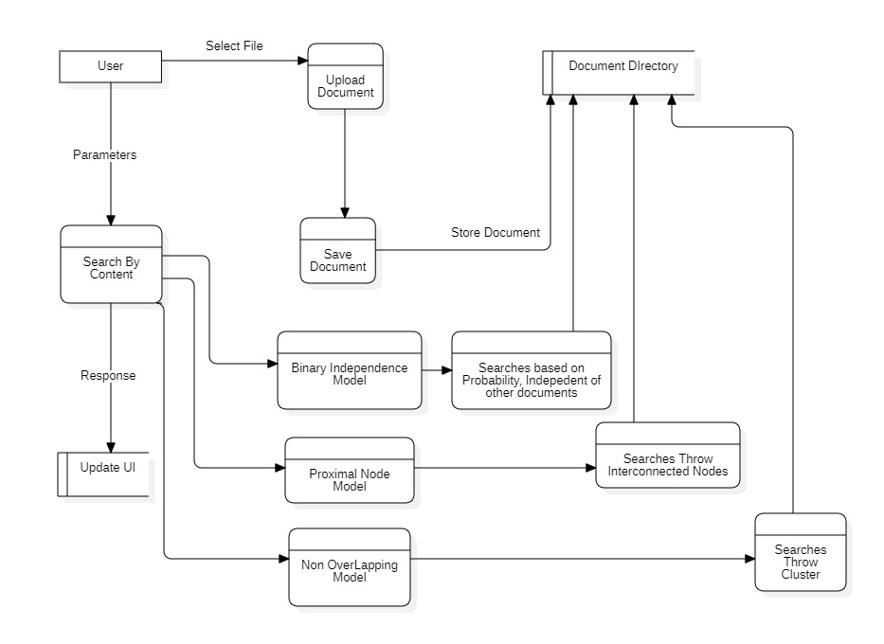
DFD

Slide 10
DFD Explanation
Select File: The user selects a file to upload.
Store Document: The uploaded document is stored in the Document Directory.
Parameters: The user provides parameters (search query) to the search process.
Search Query: The search query is passed to the search process.
Response: The search results are displayed to the user.

Slide 11
Example Use Case
1. Uploading Documents: User uploads .txt files.
2. Perform Search: User enters a query and selects a search model.
3. Retrieve Results: Results are displayed based on relevance.

Slide 12
Technical Details
• Programming Language: Python
• Framework: Django
• Search Algorithms: BIM, Non-Overlapped Lists, Proximal Nodes
• Data Storage: Files in documents/ directory, indexed in a dictionary.

Slide 13
Future Improvements
• Integrate machine learning models for enhanced semantic search.
• Add support for additional file formats (PDF, Word).
• User-friendly front-end with advanced filters and pagination.

